Slide 1
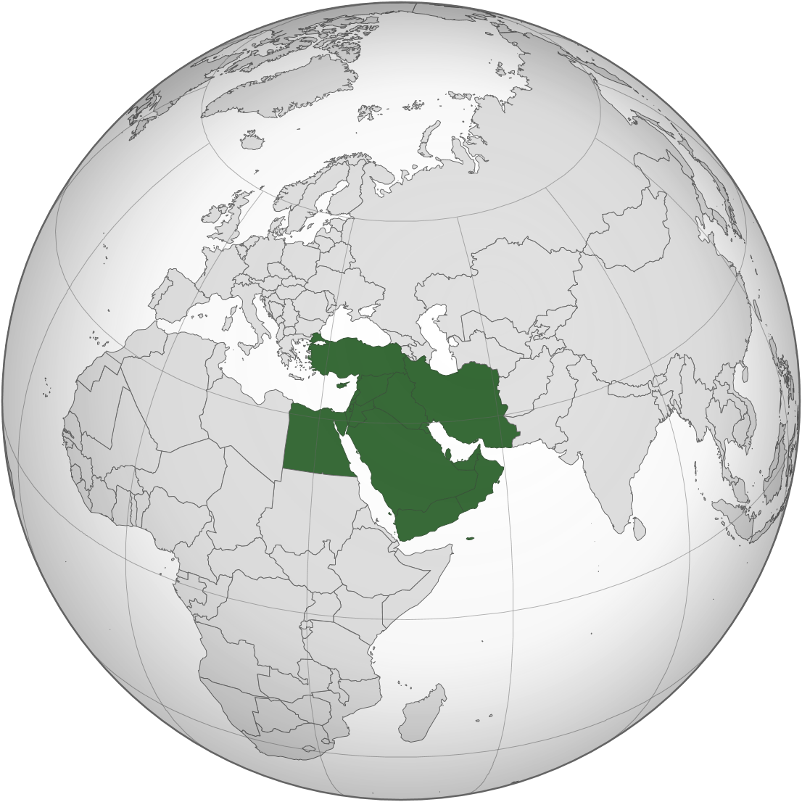
IXP+ based observations on peering and routing changes after Middle East cable outages.
Kaj Kjellgren, nog.fi 2025.11, Helsinki

Slide 2
DE-CIX is the world's #1 Cloud & Internet Exchange operator, and the world's largest carrier-neutral interconnection ecosystem
60
Internet & Cloud Exchanges
50+ Cloud service providers
600+ metros
1,000s of data centers
4,000+ connected networks
185+ Tbits capacity
North America
Chicago, Dallas, Houston,
Mexico City, New York, Phoenix, Queretaro, Richmond, Seattle
Asia Pacific
Brunei, Chennai, Delhi, Hyderabad, Jakarta, Johor Bahru, Kuala Lumpur, Kolkata, Manila, Mumbai, Osaka, Penang, Singapore, Tokyo
South America
Sao Paulo, Rio de Janeiro
EMEA
Amsterdam, Aqaba, Athens, Baghdad, Barcelona, Berlin, Bucharest, Copenhagen, Doha, Dubai, Dusseldorf, Esbjerg, Frankfurt, Hamburg, Helsinki, Istanbul, Karachi, Kinshasa, Kristiansand, Lagos, Leipzig, Lisbon, Madrid, Marseille, Munich, Oslo, Palermo, Prague, Riyadh*, Ruhr region, Sofia, Stockholm*, Warsaw
* Coming soon

Slide 3
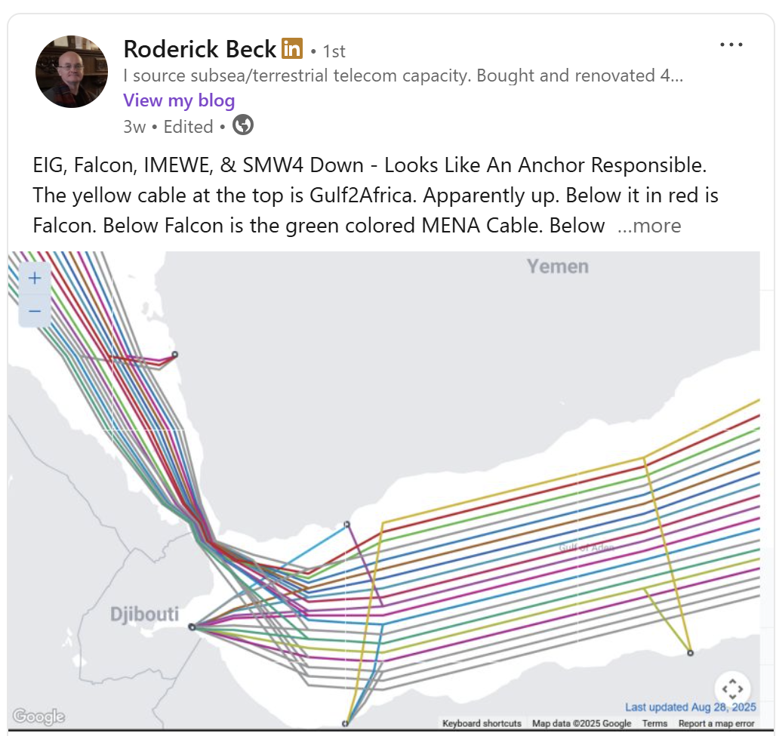
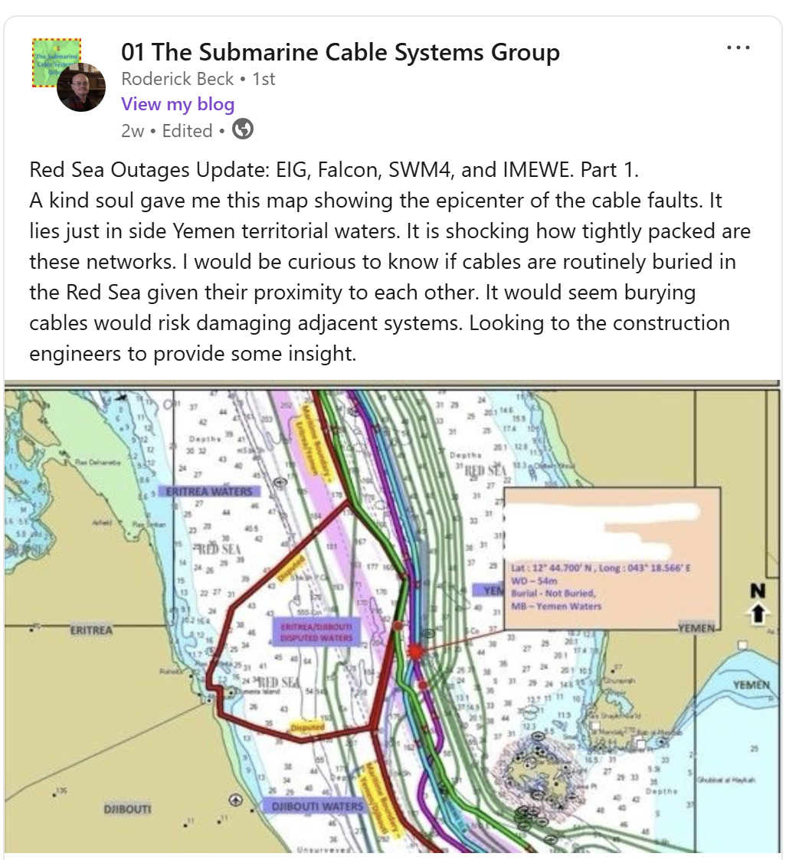
1) Which cable outages did we look at?
On 6´th of September we saw these:
https://www.linkedin.com/in/roderick-beck-94868948/recent-activity/all/

Slide 4
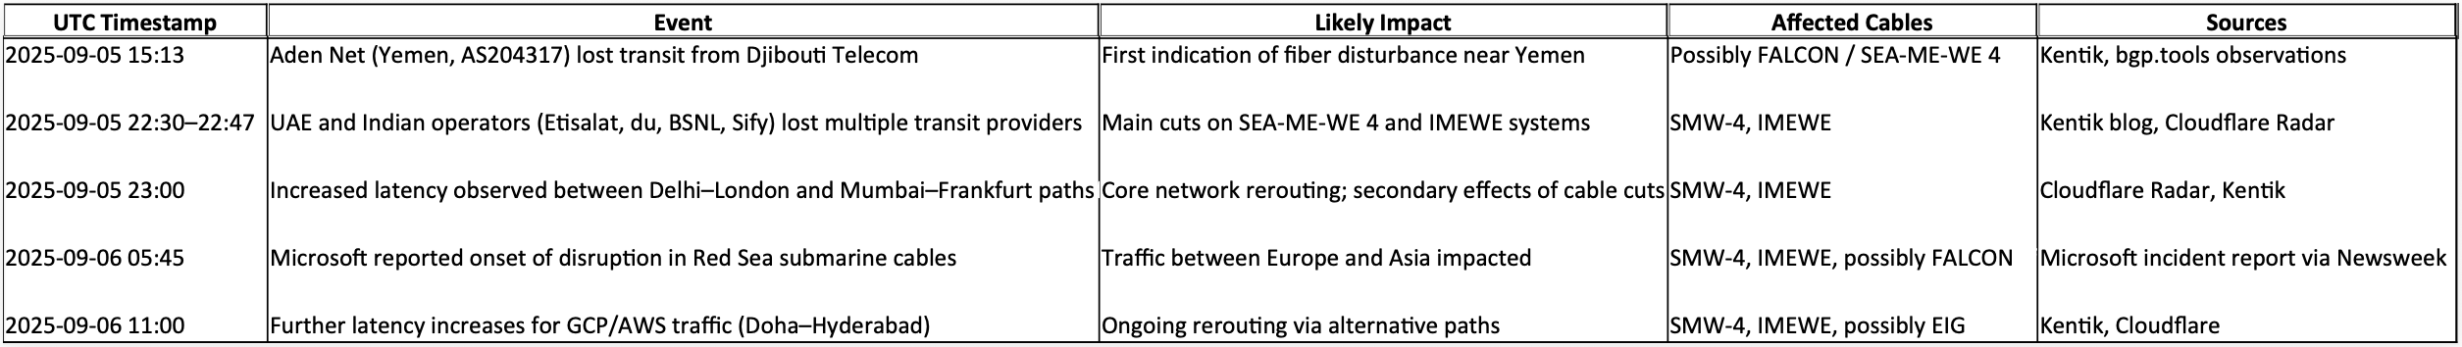
1) Which cable outages did we look at?
After digging through blogs and news-coverage, a rough timeline (might) be concluded:

Slide 5
What to expect? What not to expect...
Yes:
Insights from the IXPs we operate
Conclusions of collected data from RIPE Atlas
Statistics from colleague IXPs
And maybe some general comments on this topic
No:
The Perfect Solution(tm)

Slide 6
Assumption #1
01
We thought there must be a big change in IXP traffic…

Slide 7
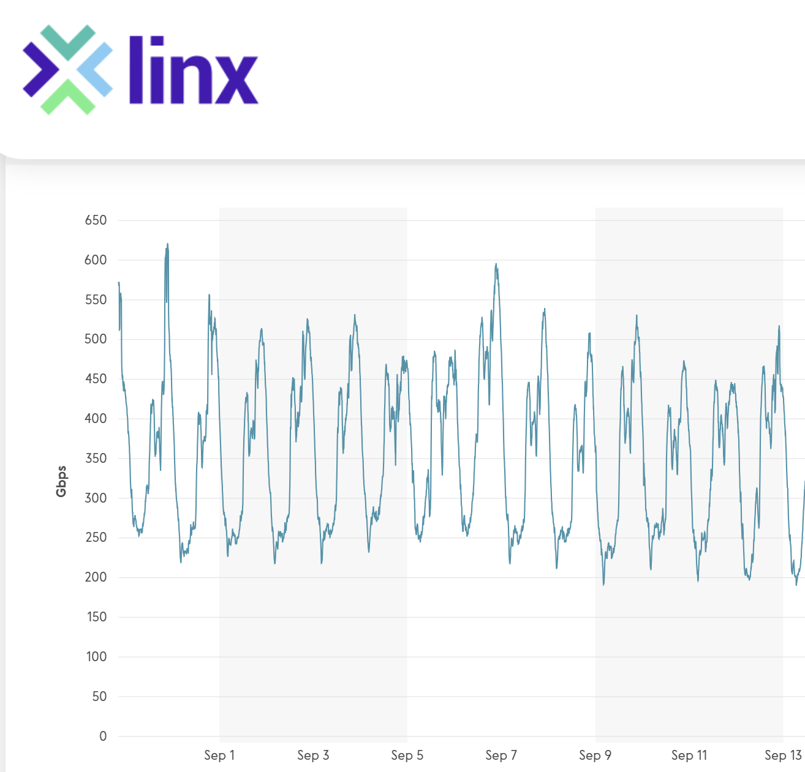
So, let's have a look: LINX Jeddah (until13/9)
Nothing spectacular
6.9. + ca. 1 week
https://portal.linx.net/services/lans-snmp/jed1, 29.9.2025

Slide 8
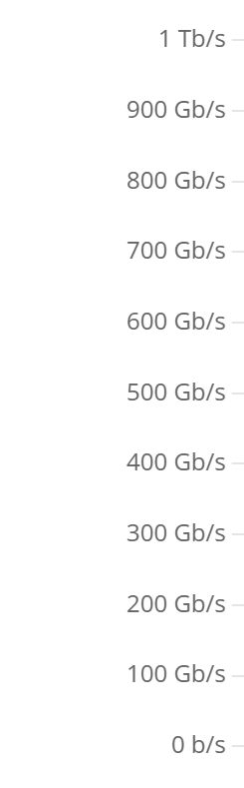
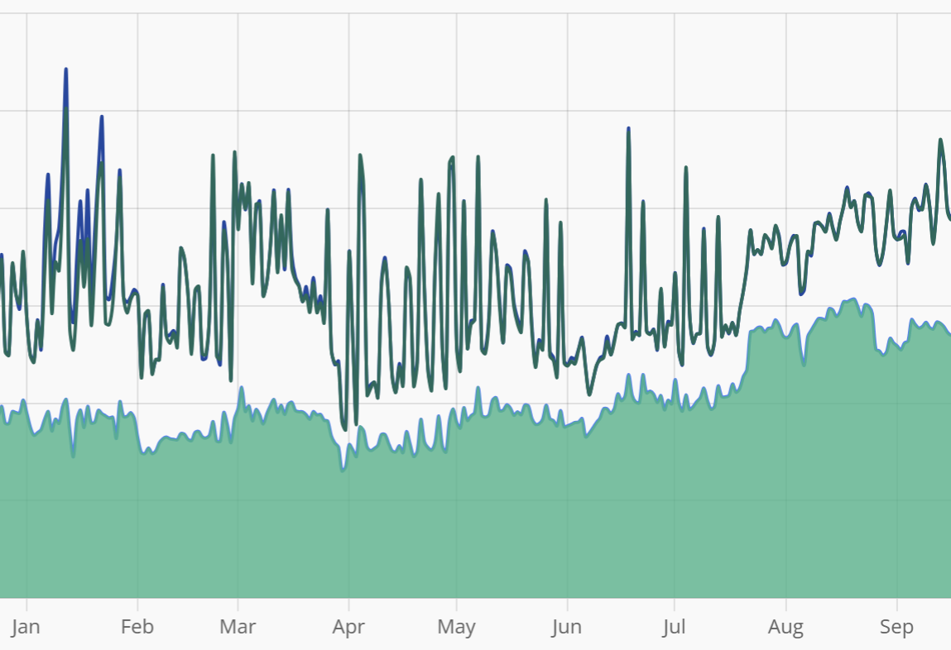
How about... SAIX Jeddah + Riyadh (until 13/9)
Nothing spectacular
https://www.saix.sa/en/services/statistics/, 29.9.2025

Slide 9
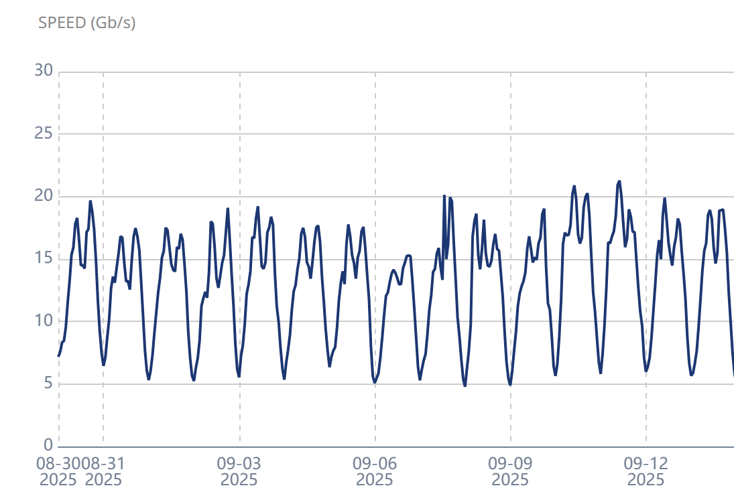
Well... here then? Equinix Muscat (until 13/9)
Nothing spectacular
https://www.equinix.com/products/interconnection-services/internet-exchange, 29.9.2025

Slide 10
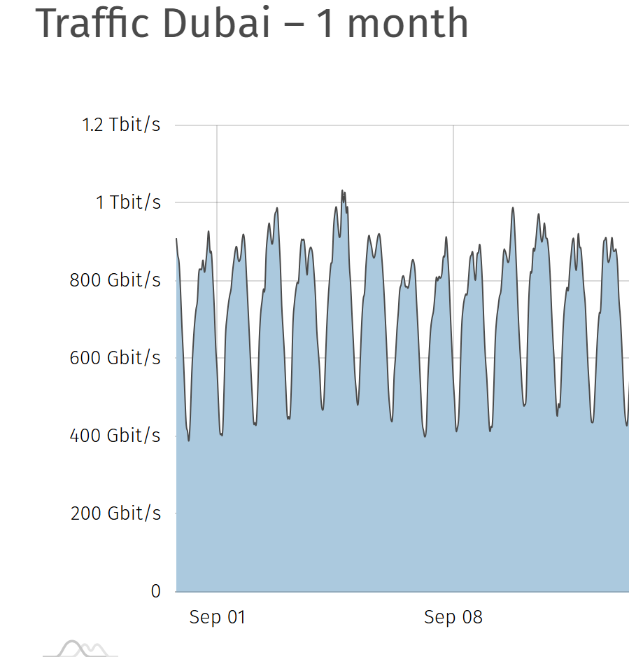
So, what about here? UAE-IX (until 13/9)
Nothing spectacular
https://www.uae-ix.net/en/location/traffic-statistics, 29.9.2025

Slide 11
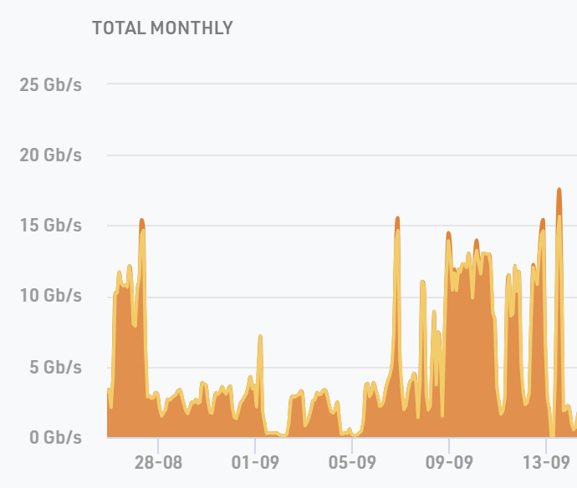
Aha, here's something: AMS-IX Djibouti (until 13/9)
Yes – something interesting for sure

Slide 12
Well, not really what we expected?
So, (almost) nothing happened? Is that it?

Slide 13
Meanwhile in FRA…
02
We thought … well I don't know what we thought…

Slide 14
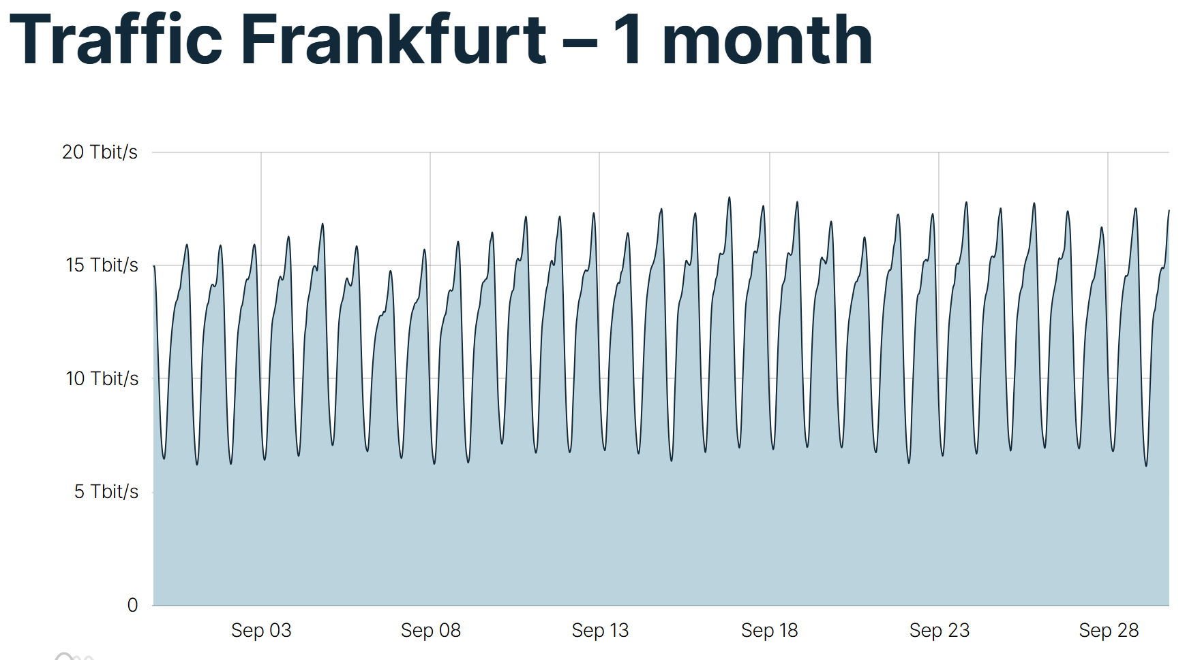
Do we see something in Frankfurt?
well, yes, maybe?

Slide 15
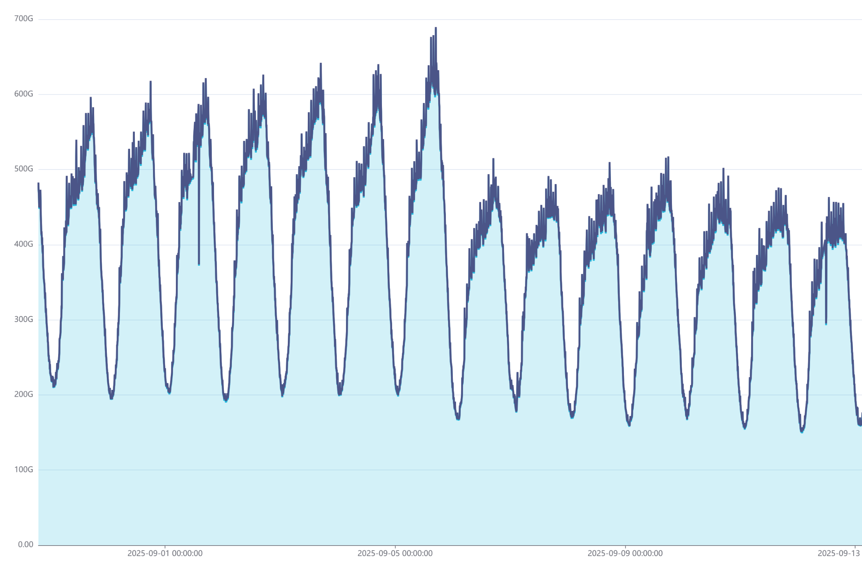
Again: Do we see something in Frankfurt?
well, yes, maybe?
oh yes, customer #1

Slide 16
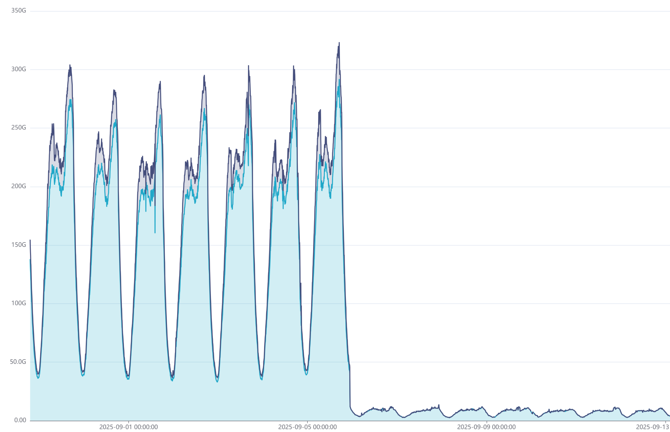
Do we see something in Frankfurt?
well, yes, maybe?
oh yes, customer #2

Slide 17
Conclusion on Frankfurt?
Lost traffic
Some traffic went away
Some other traffic came in

Slide 18
Meanwhile in MRS…
03
Aha, so that is where some of it went

Slide 19
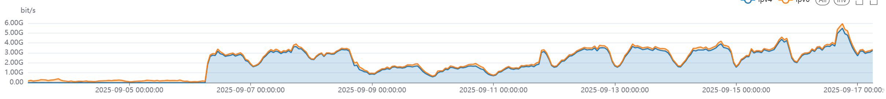
Marseille
Traffic shift from one of the content networks from FRA to MRS to a specific Middle East Operator:
Frankfurt
Marseille
Assumed reason: re-balance traffic from broken capacities to Frankfurt
onto working ones in Marseille

Slide 21
Maybe we didn't look deep enough…
04
Let's extend the time window:

Slide 22
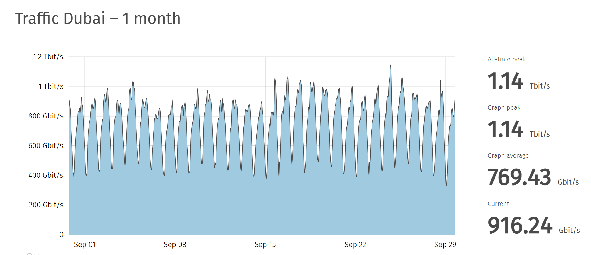
How about the 2'nd half of September?
https://www.uae-ix.net/en/location/traffic-statistics, 29.9.2025

Slide 23
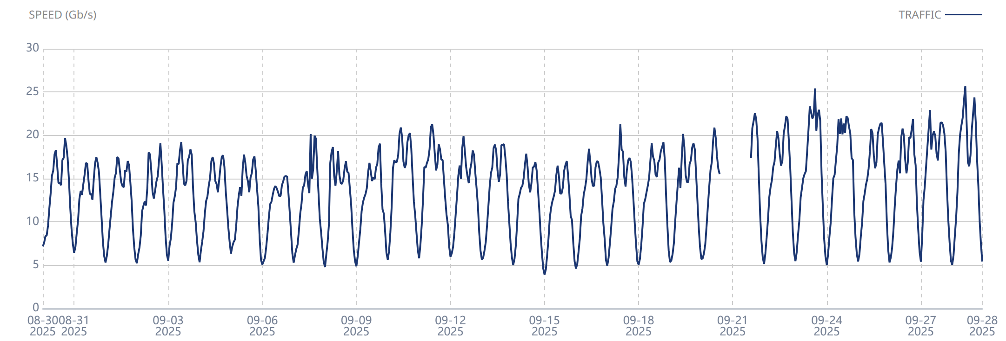
How about the 2'nd half of September?
Equinix Muscat
https://www.equinix.com/products/interconnection-services/internet-exchange, 29.9.2025

Slide 24
Conclusion on Middle East?
Some IXP needed a bit of time?
A general Trend: no

Slide 25
interesting observations...
05

Slide 26
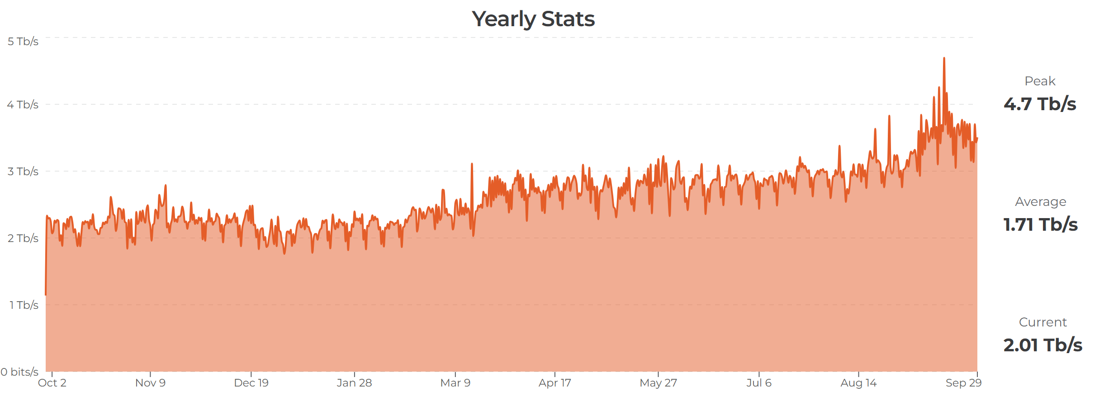
Meanwhile in India
ExtremeIX
https://extreme-ix.org/resources/traffic-stats, 29.6.2025

Slide 27
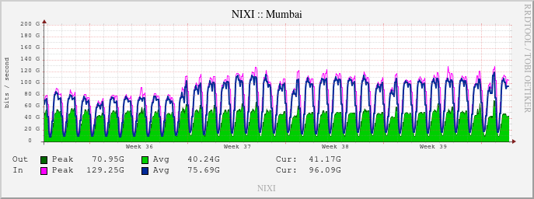
Meanwhile in India
Nixi
http://180.179.222.83/statistics/infrastructure/4/bits, 29.6.2025

Slide 28
Conclusion on India?
…something is seen … ?

Slide 29
so where did ME “stall”:
06
Looking at limitations

Slide 30
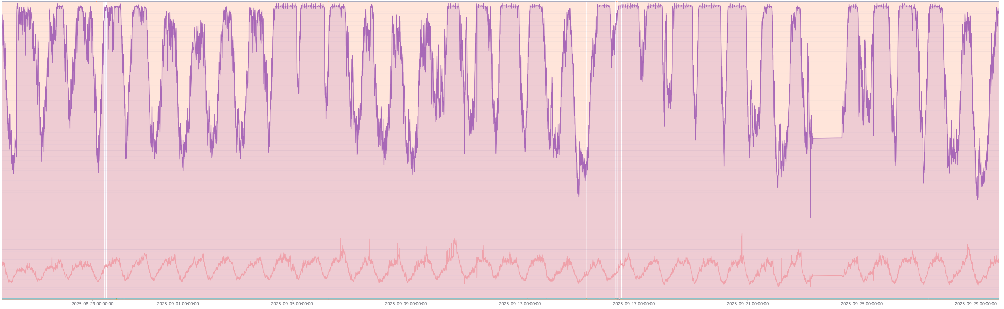
Looking at Limitations when traffic shifts occurs
Quoting Cisco: a link > 70% load is a dead link
100% load is not your friend
No, you can´t do anything useful here:

Slide 31
What did the routing do?
07
Latency Results vs. Peering/BGP configs

Slide 32
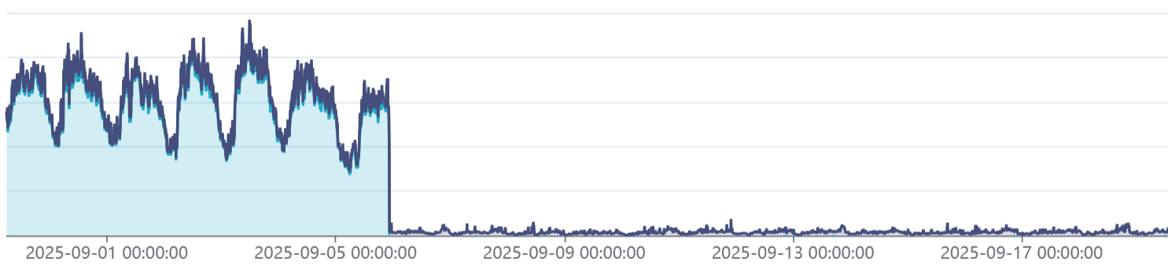
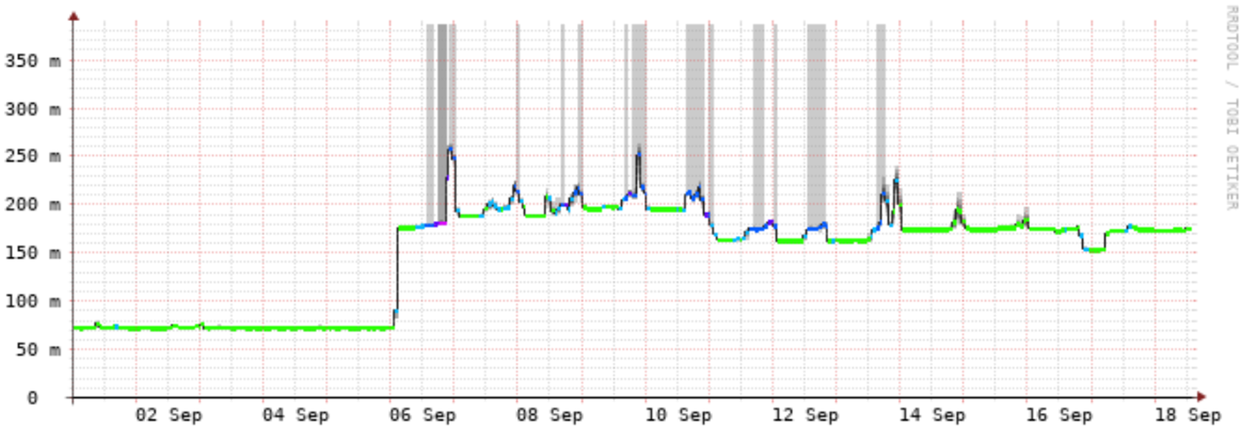
Routing vs. Latency:
Peering traffic at UAE-IX
A random Example
One big network in Saudi Arabia to one big network in UAE:
Why put traffic from Dubai via Europe if Europe cables are hit?

Slide 33
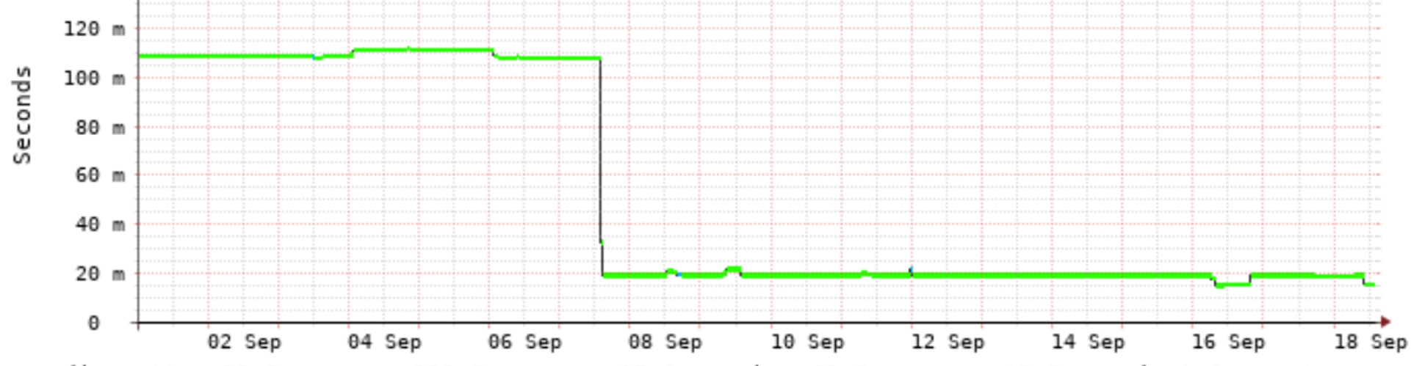
Routing vs. Latency:
Another random Example – showing the reverse:
Another big network in Saudi Arabia to one big network in UAE:
Interesting: a bit of a delay of 1 day…

Slide 34
How about hyperscalers?
08

Slide 35
Hyperscalers:
Working on getting their statements

Slide 36
How about Operators?
09

Slide 37
Operators
Working on getting their statements

Slide 38
Conclusion?
10

Slide 39
Conclusions:
Make sure your routing policy is keeping local things locally
Don't let the timestamp decide the routing
Have redundancy local
(but not in the subsea cable next to the first one)
Leave headroom on your critical links and peers

Slide 40
Conclusions:
Automate your failovers as much as possible (and test)
Learn from this (and past) incidents and improve
Make sure to send competent engineers to the NOG's
And... we need more data to get exact answers for all cases

Slide 41
Thank You
Kaj Kjellgren
Senior Peering Consultant @ DE-CIX
https://www.linkedin.com/in/kajkjellgren/

